Slide 1
StackReQA:
Stack Overflow Retrieval Question Answering
Alyssa Augsburger
John Lee
Sanjay Saravanan
April 15, 2021
Notes:
ALYSSA
Hi, we are John, Sanjay, and myself, Alyssa. In this presentation, we will present StackReQA: Stack Overflow Retrieval Question Answering.

Slide 2
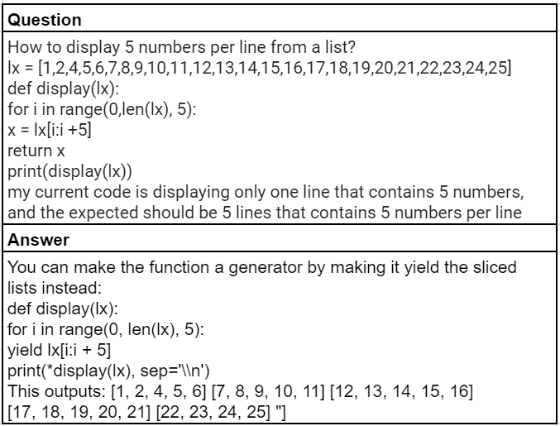
Introduction
Goal
Identify the best Stack Overflow answer to a proposed question
Approach
Represent text and code with different embeddings
Apply different ordering techniques
Utilize different architectures
Notes:
ALYSSA
Retrieval question answering tasks provide a path for systems to retrieve relevant answers to a question.
We are motivated by helpful solutions for programming questions from Stack Overflow. Our goal is to identify the best Stack Overflow answer to a proposed question.
We applied data preprocessing techniques in conjunction with a variety of architectures to learn which combinations produced the best results.
We focused on text and code representation, ordering techniques, and embedding combinations in varied model architectures.
The challenge in this task is the handling of both text and code snippets.

Slide 3
Background
ReQA: An Evaluation for End-to-End Answer Retrieval Models Ahmad et. al., 2019
End-to-end solution
Model should be contextually aware
Semantic Similarity and Response Prediction for Programming QA Kulkarni and Rosich, 2020
Solved a similar problem, but excluded code snippets
MultiReQA: A Cross-Domain Evaluation for Retrieval Question Answering Models Guo et. al., 2020
Evaluated retrieval tasks using supervised neural models based on BERT and USE-QA
Notes:
ALYSSA
Retrieving the best answer is a difficult problem and becomes more challenging when there is a large corpus to retrieve relevant answers from.
We’re motivated by the previous work of others on retrieval question answering tasks.
One specific motivation is the work of Kulkarni and Rosich who solved a similar problem of predicting the best response to questions from Stack Overflow textual data. They don’t include code snippets in order to reduce record size for their models. We solved a similar problem, but strived to improve on their findings by including code fragments in our models, as we believe they can provide additional context.

Slide 4
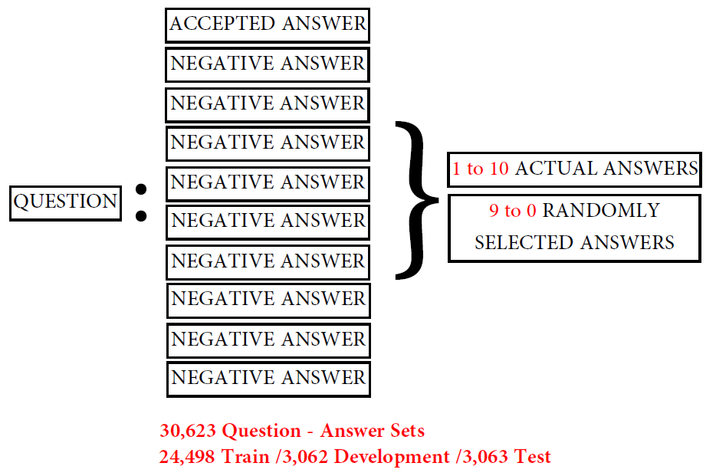
Task & Data
Task
Given 1 question, pick best of 10 answers
Data
30,623 Unique Questions
60,335 Answers
<5% without code
<5% without text
Notes:
John
Our experiments were set up so that for every question, our model would return the best response out of 10 answers.
These question-answers sets were created by associating each of the 30,000+ questions with 10 answers consisting of 1 accepted answer and 9 negatives. The negative answers included non-accepted answers from other contributors plus randomly selected answers from our dataset as necessary to meet the 10 answer requirement.
Less than 5% of our data did not have either code or text indicating that it is wise for our model to represent both text and code in our embeddings.

Slide 5
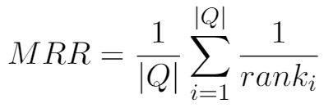
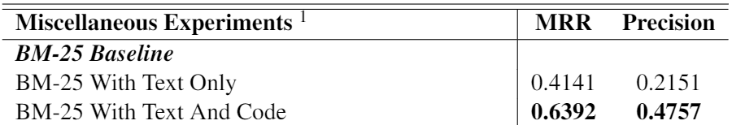
Evaluation & Baseline
Evaluation
Mean Reciprocal Rank (MRR)
Precision
Baseline
BM-25
Notes:
John
We select the mean reciprocal rank as our primary metric because it captures the rank of the predicted results. An MRR of 1.0 means that the model labels the correct answer as rank 1 every time. We use precision as a secondary metric.
We select BM-25 on text and code data as our baseline. Note that BM-25 with text and code performs 54% better than just text alone, further supporting the inclusion of code in our embeddings.

Slide 6
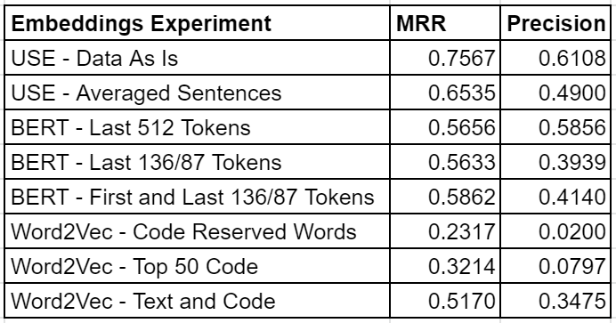
Strategy - Representation
Universal Sentence Encoder (USE)
Bidirectional Encoder Representation for Transformers (BERT)
Word2Vec
Notes:
ALYSSA
We embedded the questions and answers with USE, BERT, and Word2vec and experimented with various combinations of these.
We also applied different methods of embedding the data, such as averaging sentences with USE, and varying the sequence selections and maximum sequence lengths with BERT and Word2Vec.
For each embedding variation, we ran a dual encoder model to evaluate the performance of the embedding technique and then used the best performing technique in our subsequent neural models.

Slide 7
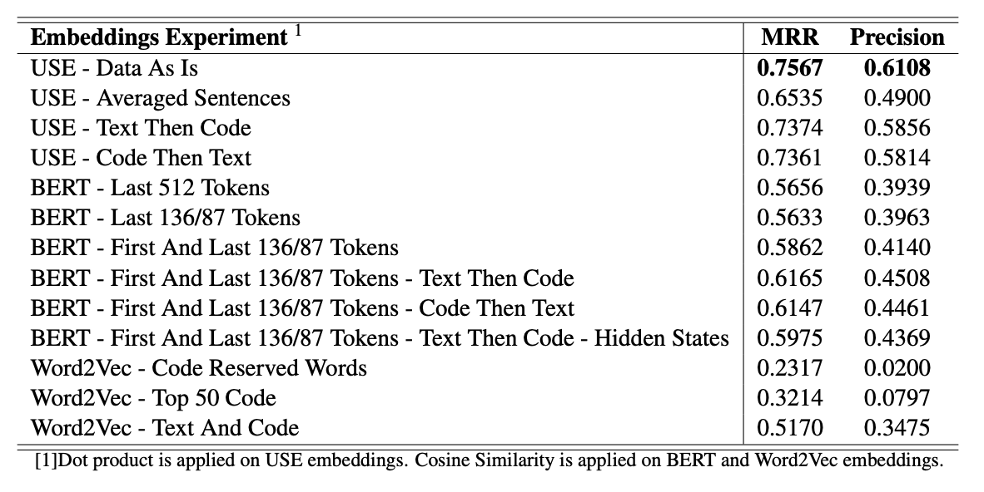
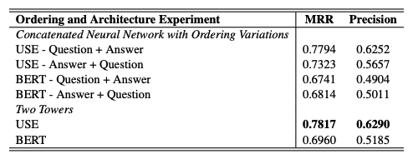
Strategy - Ordering
Notes:
SANJAY
A second strategy we focus on is ordering.
We first vary ordering of our data with Text appearing before Code and vice versa as seen in top table above.
For USE, this didn’t help and using data as is performed best
For BERT, Code Then Text ordering performed best
Next, we vary ordering of input embeddings for our models with Question + Answer or Answer + Question as seen in bottom table.
For USE, Question + Answer approach performed best
For BERT, Answer + Question approach performed best and it is difficult to state if there is any other reason other than luck based on randomized model weights initialization

Slide 8
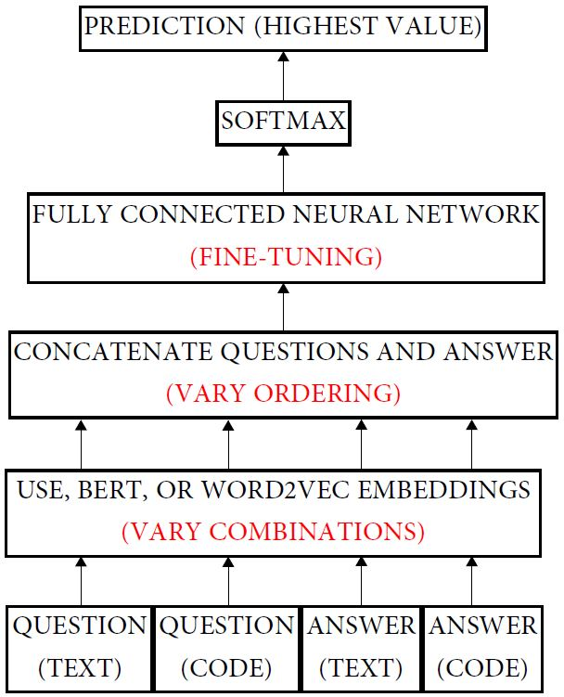
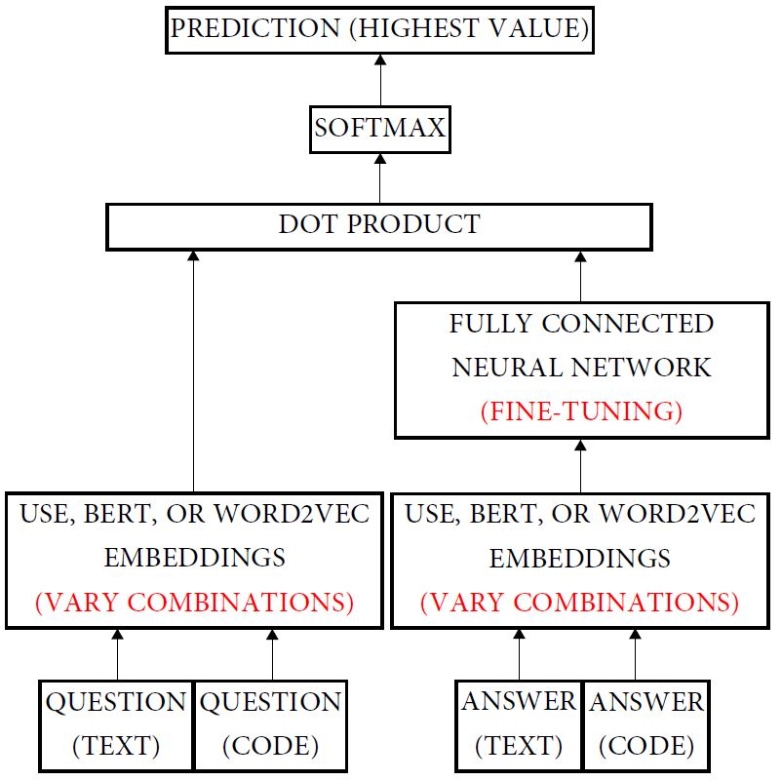
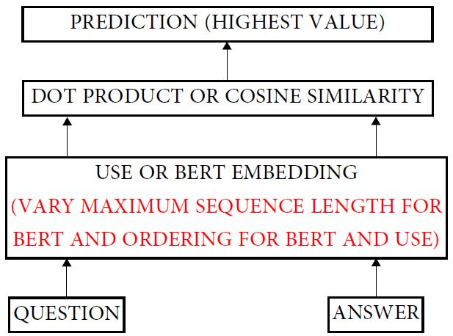
Strategy - Architectures
Dual Encoder
Concatenated Neural Network
(Early Fusion)
Two Towers
(Late Fusion)
Notes:
John
For our third strategy, we built various architectures. The Dual Encoder architecture dot products or computes cosine similarity to quickly filter out underperforming pre-processing strategies prior to running fine-tuned models like early and late fusion architectures.
The early fusion concatenates the embeddings prior to the fully connected layers while the late fusion dot products the embeddings after they’re fed through fully connected layers.
We find that that the late fusion performed better in most variations of representation and ordering.

Slide 9
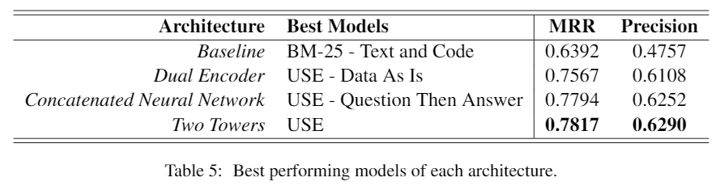
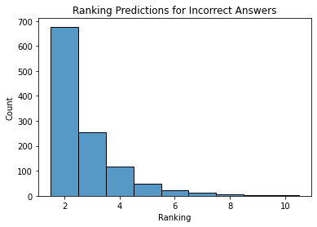
Results & Error Analysis
Hyperparameters
Single dense layer
512 nodes
Adam Optimizer
Learning Rate - 0.001
Sparse categorical cross-entropy loss
Batch size - 64
2 epochs
Notes:
SANJAY
As seen in above table, USE embeddings perform best across all three architectures.
Our best model is two towers with USE embeddings using data as is, which produced an MRR of 0.78, a 22% improvement over our baseline.
We find that including code improves our model’s performance and that USE does a better job of capturing semantic context of code than Word2Vec and BERT.
Not much fine-tuning is required for USE to produce accurate predictions regarding similarity between questions and answers, as USE two towers performed only 3% better than the dual encoder architecture.
According to the histogram, we note that out of all of the incorrect predictions, the accepted answer to questions was most frequently predicted as the second-ranking answer.
Majority of those predicted answers turned out to be related answers to the question instead of randomly selected answers.
In the cases where the accepted answer was ranked second, the predicted answer tended to have more matching tokens to the question than the actual accepted answer, causing greater confusion for the model to learn and infer.
We also note that since it is up to human interpretation on what is considered an accepted answer, it is challenging for our model to distinguish between two or more similar and helpful answers.

Slide 10
Conclusion
Experiments
Representation (USE, BERT, Word2Vec)
Ordering (Code and Text, Question + Answer, etc...)
Architectures (BM-25, Dual Encoder, Early/Late Fusion)
Future Work
Better representation of code data
More fine-tuning
Expanded dataset
Ablation Study
Notes:
SANJAY
To conclude, we apply different embedding strategies, ordering techniques, and architectures to achieve our task and we don’t exclude code in our data.
Embedding the data with USE outperforms models with BERT, Word2Vec, or varied combinations of those embeddings.
Our two towers model with late fusion performs best, yet it’s only a slight improvement over the dual encoder model.
Finally future work would involve:
Better representation of code data
More fine-tuning
Expanding our dataset
An ablation study

Slide 11
Thank You.
Notes:
Thank you for listening!

Slide 12
References
Amin Ahmad, Noah Constant, Yinfei Yang, and DanielCer. 2019. Reqa: An evaluation for end-to-end an-swer retrieval models.Proceedings of the 2nd Workshop on Machine Reading for Question Answering.
Jacob Devlin, Ming-Wei Chang, Kenton Lee, and Kristina Toutanova. 2018. BERT: pre-training of deep bidirectional transformers for language understanding. CoRR, abs/1810.04805.
Mandy Guo, Yinfei Yang, Daniel Cer, Qinlan Shen,and Noah Constant. 2020. Multireqa: A cross-domain evaluation for retrieval question answering models.
Rahul Kulkarni and Ryan Rosich. 2020. Semantic similarity and response prediction for programming qa.
Tomas Mikolov, Greg Corrado, Kai Chen, and Jeffrey Dean. 2013. Efficient estimation of word representations in vector space.
Rudi Seitz. 2020. Understanding tf-idf and bm25.
Kaggle Stack Overflow. 2019. Stack overflow data.
Chi Sun, Xipeng Qiu, Yige Xu, and Xuanjing Huang.2019. How to fine-tune BERT for text classification?CoRR, abs/1905.05583.
Yinfei Yang, Daniel Cer, Amin Ahmad, Mandy Guo, Jax Law, Noah Constant, Gustavo Hernandez Abrego, Steve Yuan, Chris Tar, Yun-Hsuan Sung,Brian Strope, and Ray Kurzweil. 2019. Multilingual universal sentence encoder for semantic retrieval

Slide 13
Paper:
https://drive.google.com/file/d/1hea45Yta-OV6DMEVH7KQXar4aSGA8Fxs/view?usp=sharing

